Slide 1
Intro to Coding with Python– Prototyping
Dr. Ab Mosca (they/them)
Slides based off slides courtesy of Jordan Crouser (https://jcrouser.github.io/)

Slide 2
Plan for Today
User-centered design
Prototyping

Slide 3
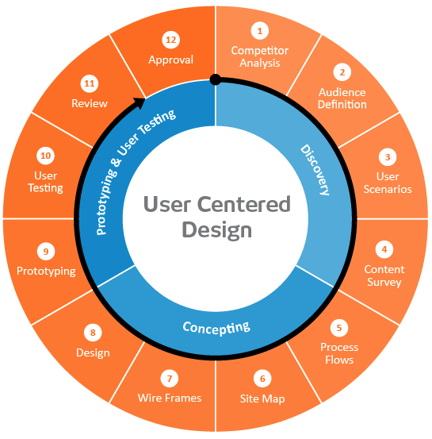

User-centered design framework
1) Discovery
Learning about your users
Modeling your users
Analyzing your users’ tasks
Eliciting and defining clear product requirements
2) Concepting Phase
Developing conceptual models
Solving design problems through ideation
Detailed design activities
3) Prototyping + User Testing
Delivery of a high-quality product that meets users’ needs and is easy to learn and use
Users
http://www.uxmatters.com/mt/archives/2010/07/design-is-a-process-not-a-methodology.php
Notes:
All Phases
Each phase feeds into the next
Iteration is key!
Users involved at all phases of the process

Slide 4
Now that we’ve got some end users in mind,
what would a prototype look like?

Slide 5
User-centered design framework
1) Discovery
Learning about your users
Modeling your users
Analyzing your users’ tasks
Eliciting and defining clear product requirements
2) Concepting Phase
Developing conceptual models
Solving design problems through ideation
Detailed design activities
3) Prototyping + User Testing
Delivery of a high-quality product that meets users’ needs and is easy to learn and use
Users
http://www.uxmatters.com/mt/archives/2010/07/design-is-a-process-not-a-methodology.php
Notes:
All Phases
Each phase feeds into the next
Iteration is key!
Users involved at all phases of the process

Slide 6
CS Life Skill #1: “Paper prototyping”
Big idea:
Not sure yet whether or not an idea will work?
Making a paper version of an interface is a lot faster and easier than coding a working prototype – start there!

Slide 7
“Paper prototyping” goals
Generate lots of ideas
Engage other people in the design process
Identify potential problems before you waste time coding
Get feedback quickly, from lots of different people
Some tips:
Focus on the big picture, don’t worry about the details
Think about what you want it to do, rather than what you know how to implement (we’ll worry about that later)
Not so into arts and crafts? It doesn’t have to be actual paper… Whiteboard / PowerPoint / Keynote will also do the trick!

Slide 8
“Paper prototyping”
Examples:
https://www.youtube.com/watch?v=nA9QP9lkl20
https://www.youtube.com/watch?v=y20E3qBmHpg
https://www.youtube.com/watch?v=yafaGNFu8Eg

Slide 9
User-centered design framework
1) Discovery
Learning about your users
Modeling your users
Analyzing your users’ tasks
Eliciting and defining clear product requirements
2) Concepting Phase
Developing conceptual models
Solving design problems through ideation
Detailed design activities
3) Prototyping + User Testing
Delivery of a high-quality product that meets users’ needs and is easy to learn and use
Users
http://www.uxmatters.com/mt/archives/2010/07/design-is-a-process-not-a-methodology.php
Notes:
All Phases
Each phase feeds into the next
Iteration is key!
Users involved at all phases of the process

Slide 10
“Architecture diagrams”
Big idea:
Now that you’ve got an idea of what your interface might look like, break that down into manageable pieces so you can get started
This can happen at several levels of detail

Slide 11
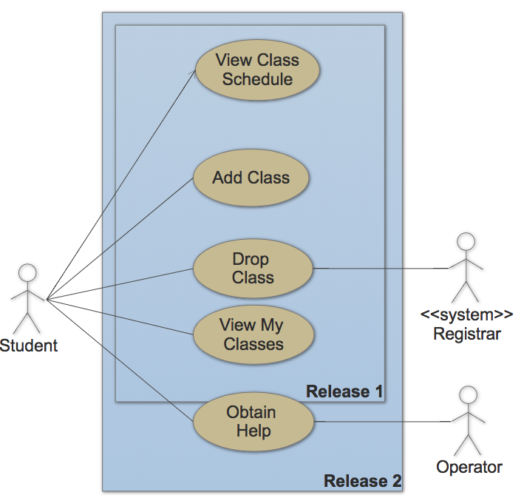
Example: use case diagram (high level)

Slide 12
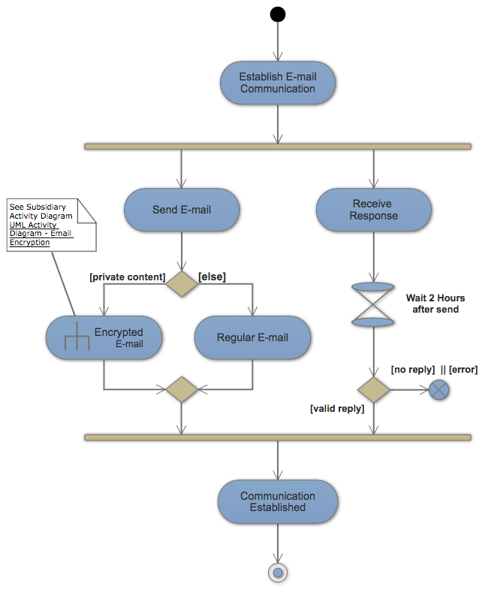
Example: activity diagram (mid level)

Slide 13
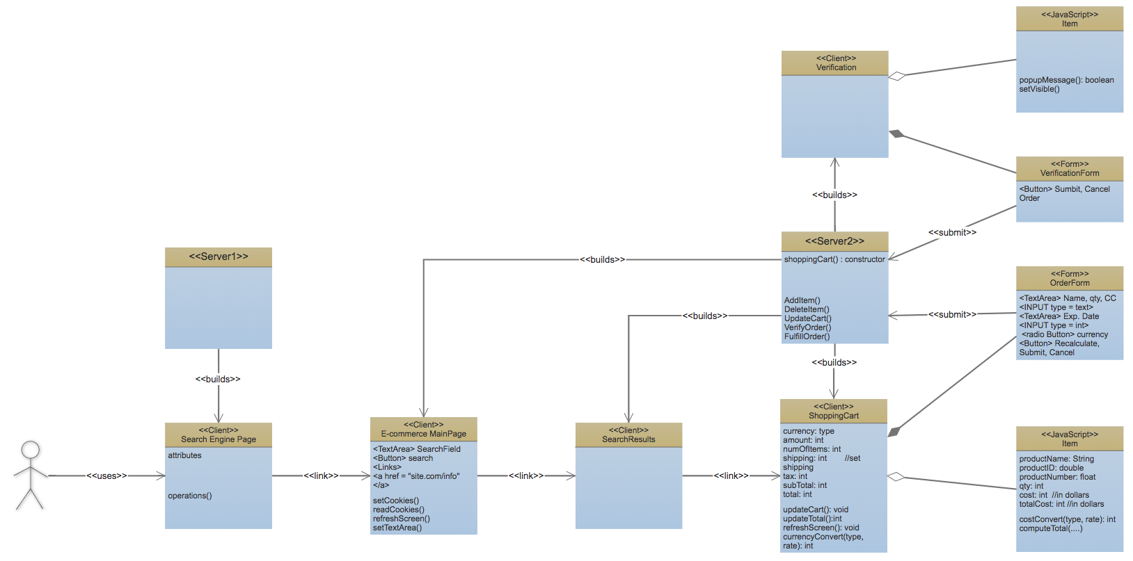
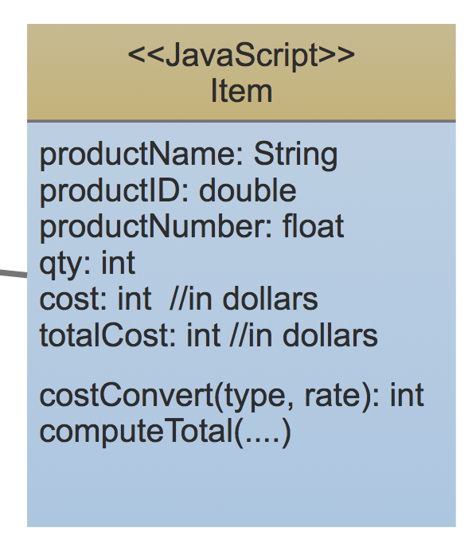
Example: class diagram (low level)

Slide 14
Your turn!
Work with a partner to create a paper prototype for a transit app. Take a picture of your prototype to turn in on Gradescope.
Notes:
Create a paper prototype for a transit app

Slide 15
Takeaways
Thinking about your end user early → you’re more likely to build something that actually solves the problem
“Low-fidelity” prototyping saves time and energy by helping identify problems before you commit to code
Architecture diagrams help you plan out your implementation so you don’t run out of time
Also, the process is kinda fun…

